Slide 1

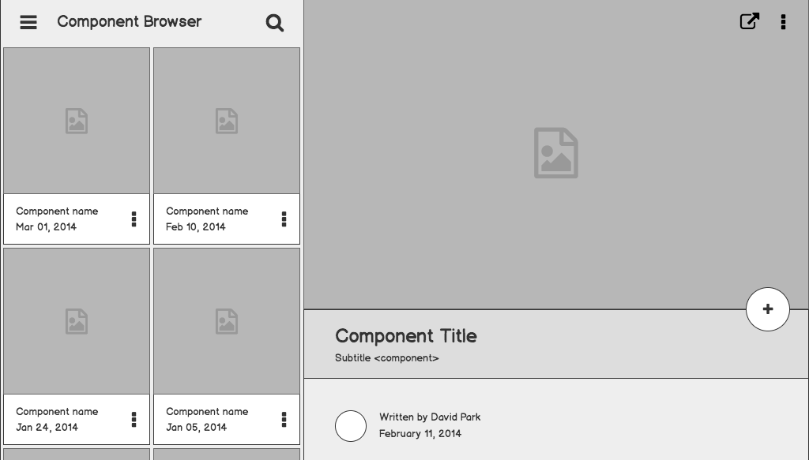

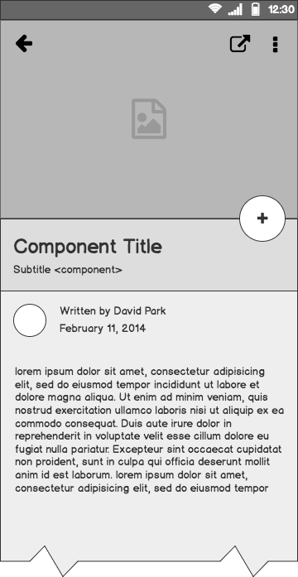
ISO Planner for Office of Intercultural and International Life
Lydia Chau, Gracie Little, Tresa Xavier

Slide 2
Our community partner: OIIL
Office of International & Intercultural Life
Hosts International Student Orientation annually
Coordinates events with multiple offices across Campus to create schedule
Notes:
Discuss current system, downsides to email

Slide 3
Goals and Design Influences
Create a scheduling system
Easy and intuitive to use
Minimize communication outside the system
Google Calendar
When2meet
Google Surveys
Notes:
Existing system is communication entirely through email, which is innefficient and requires a lot of back and forth. After meeting with the office director

Slide 4
Design Requirements
Separate interfaces for OIIL and other offices
Offices can create events and submit availability
OIIL can create events, finalize a calendar, and notify other offices of final schedule
Notes:
Talk about how oiil informed design workshop presentation activity, color coding

Slide 5
Wireframes: OIIL View

Slide 6
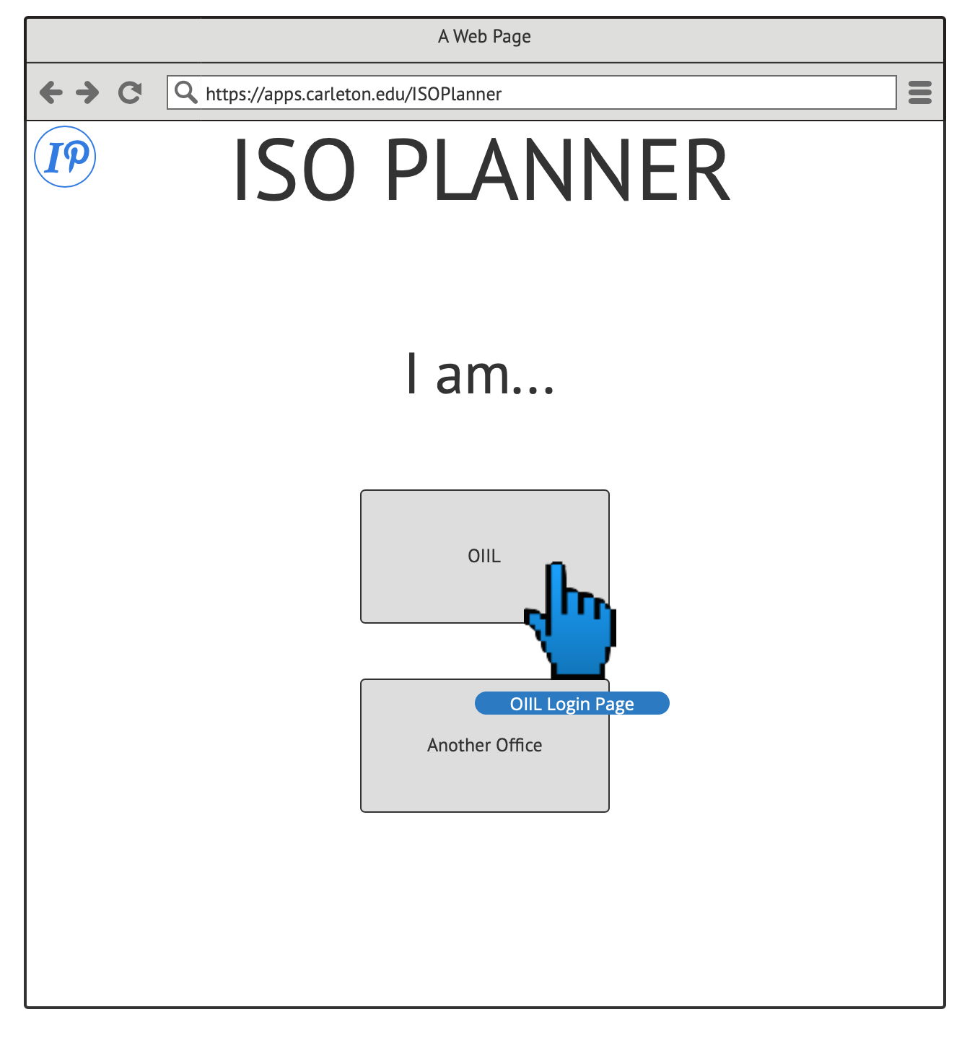

Slide 7
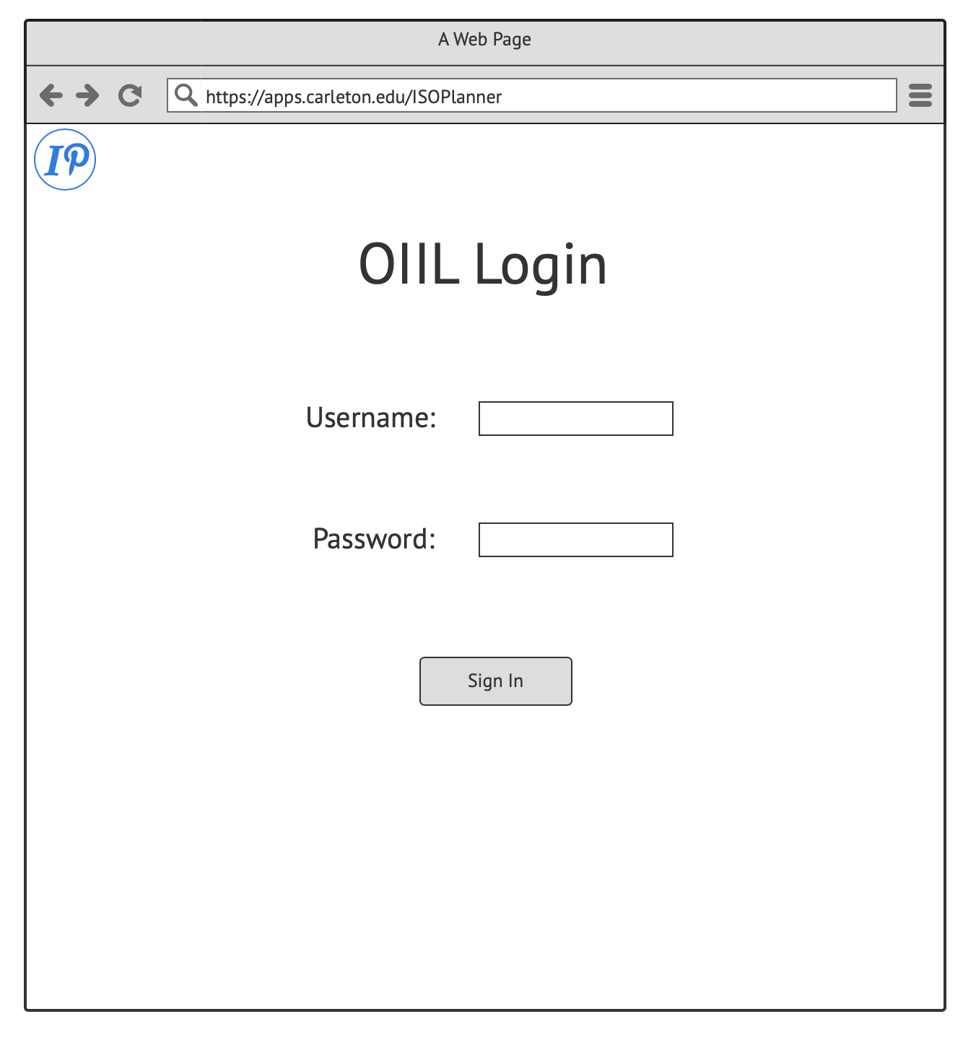

Slide 8
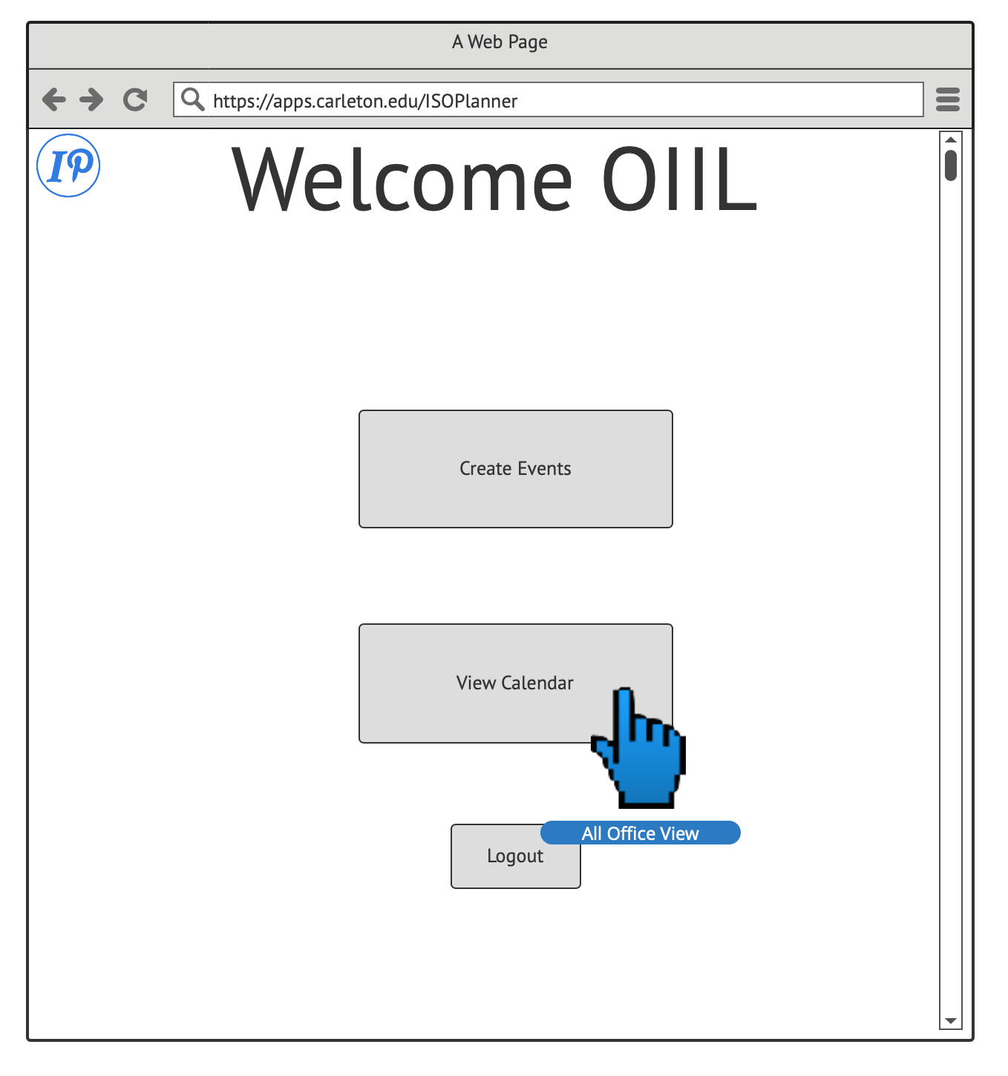

Slide 9
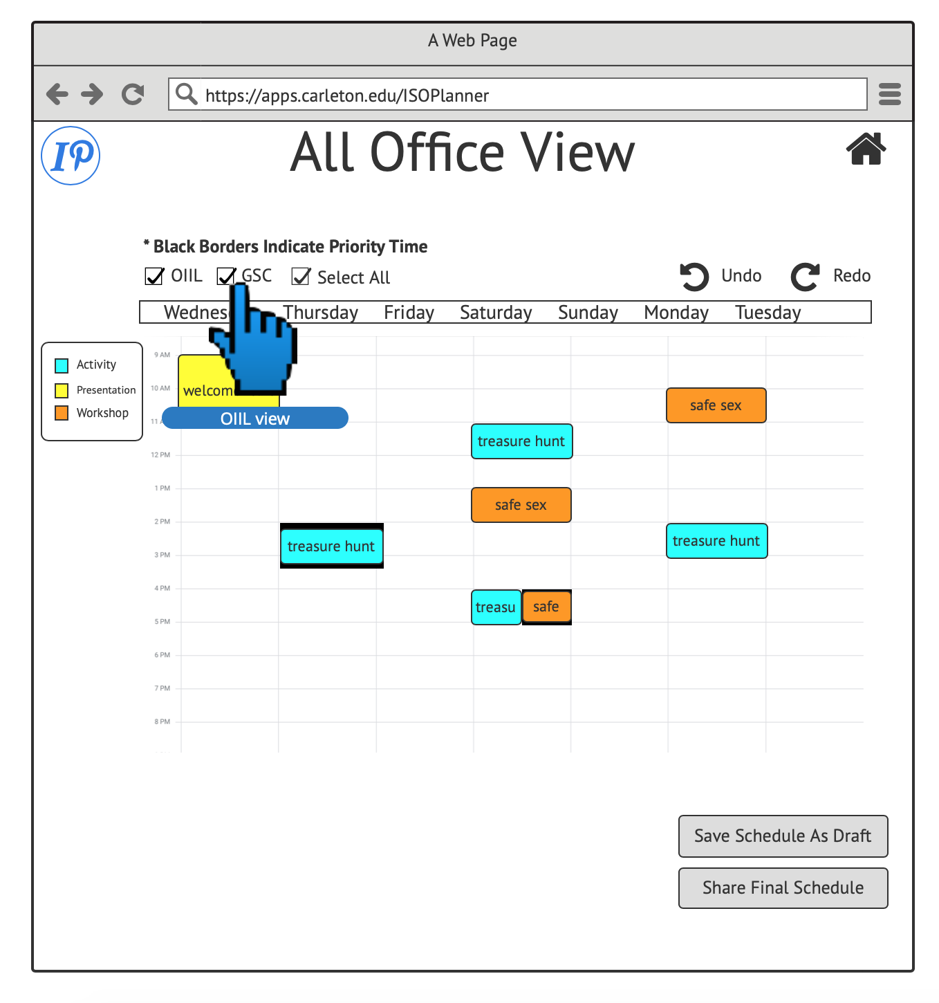

Slide 10
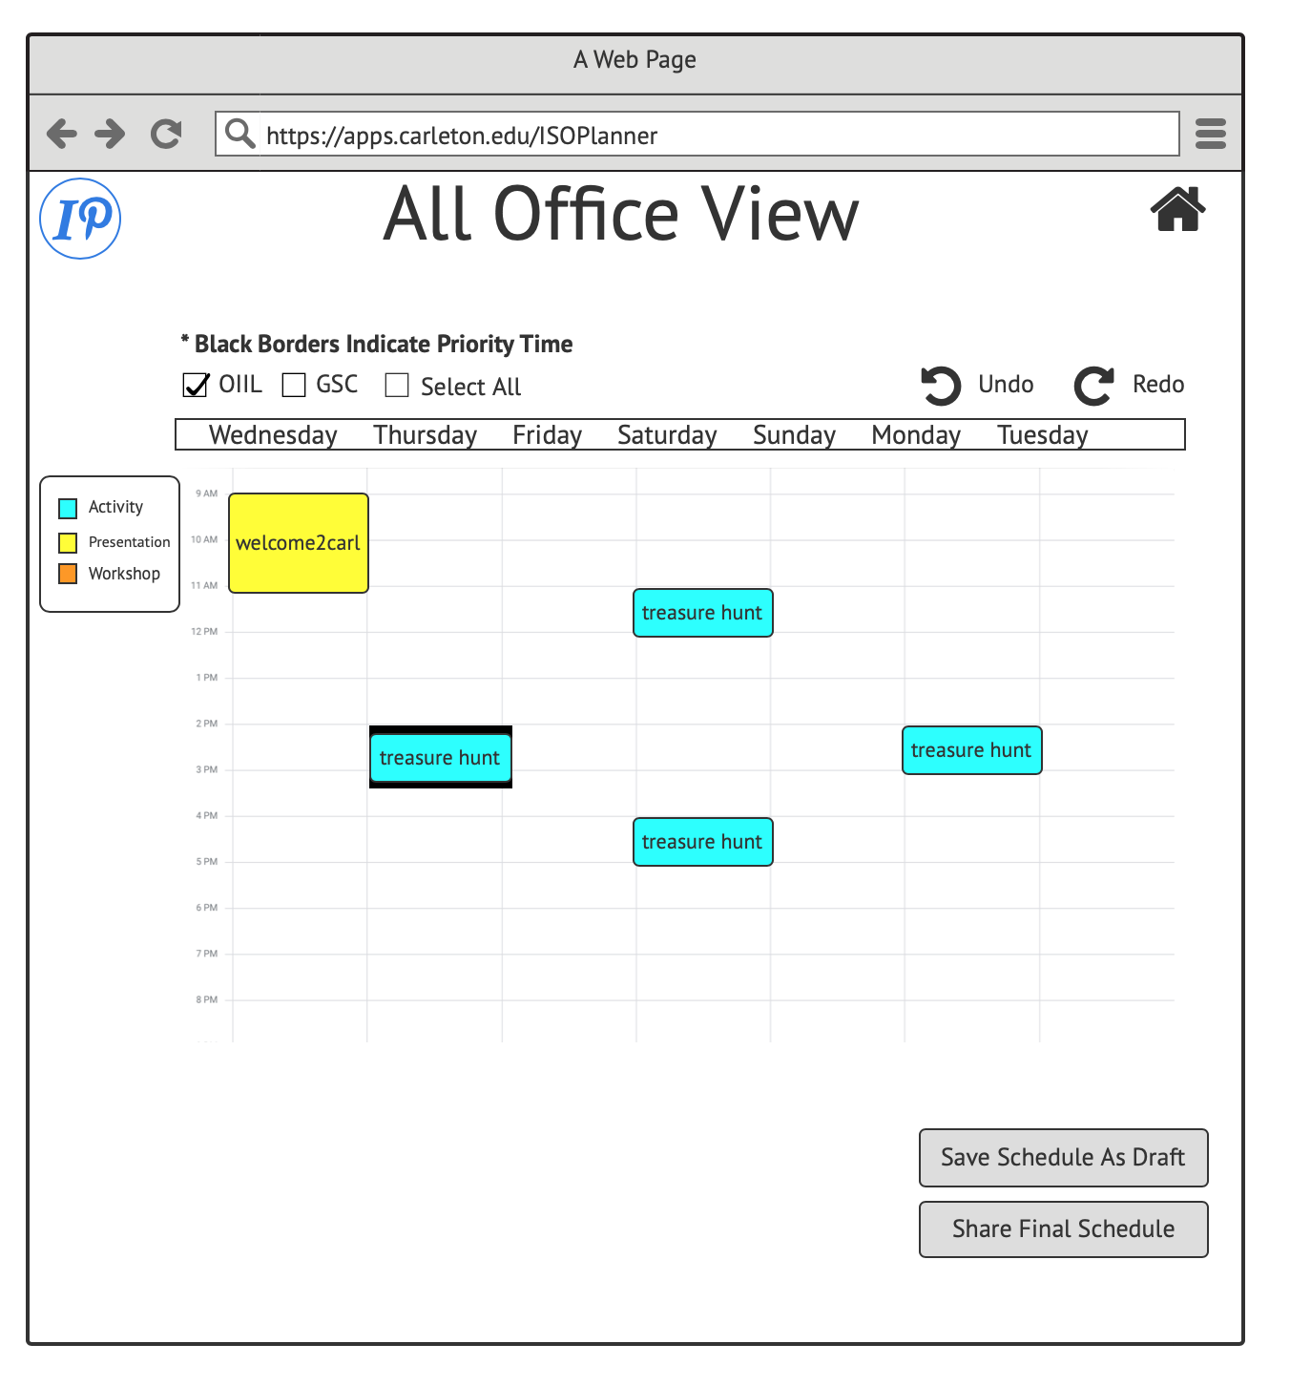

Slide 11
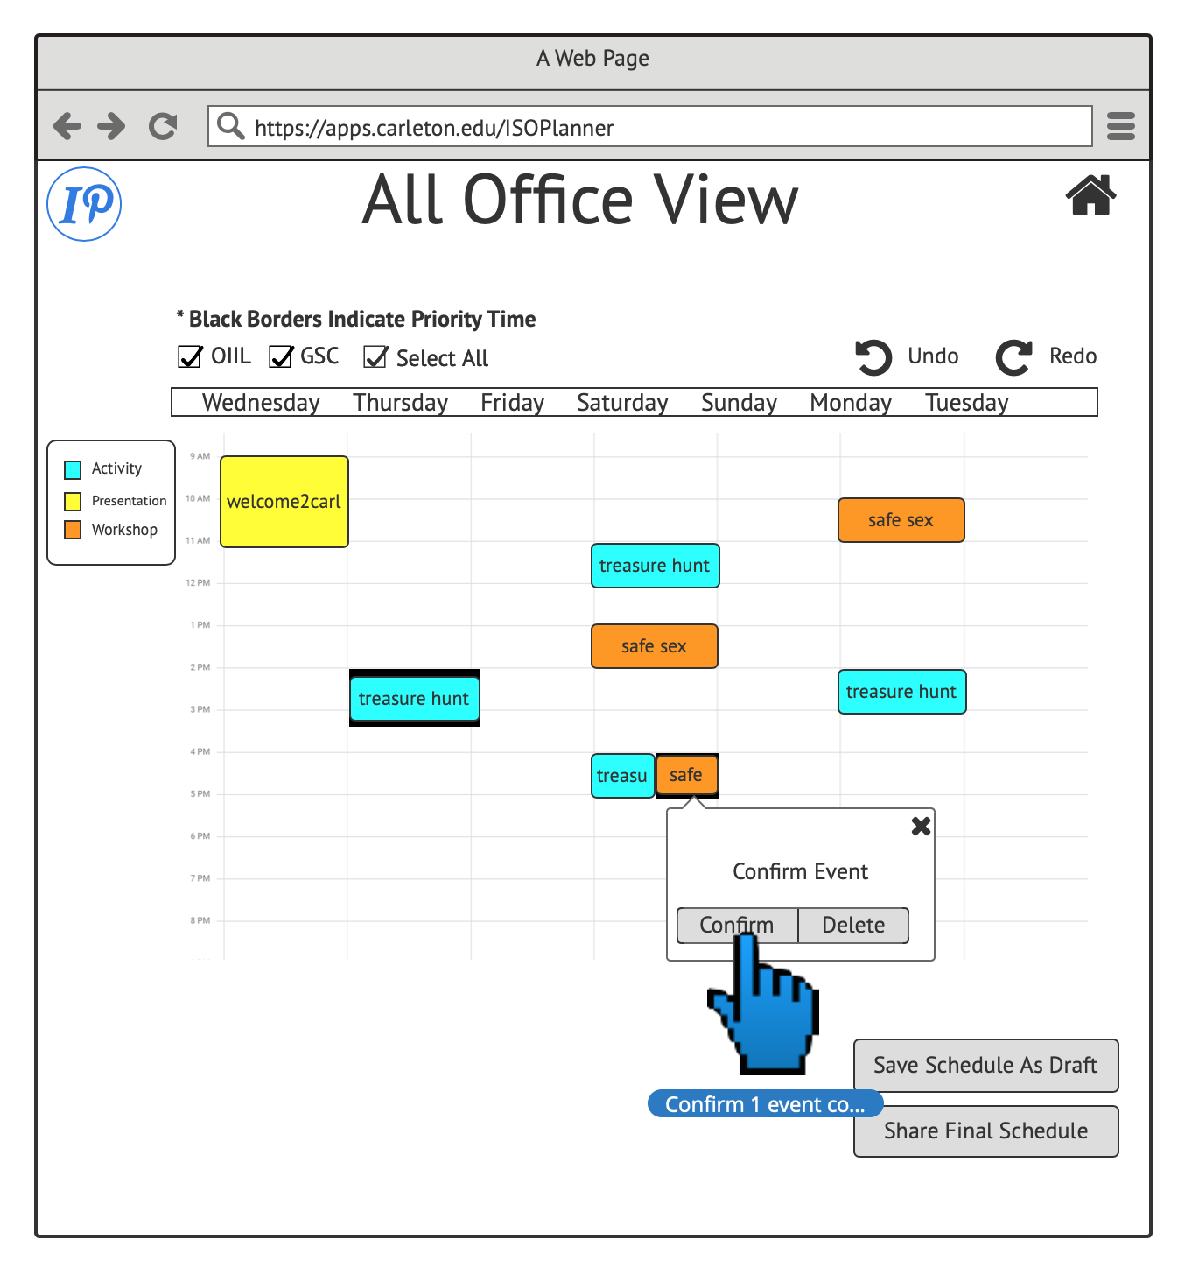

Slide 12
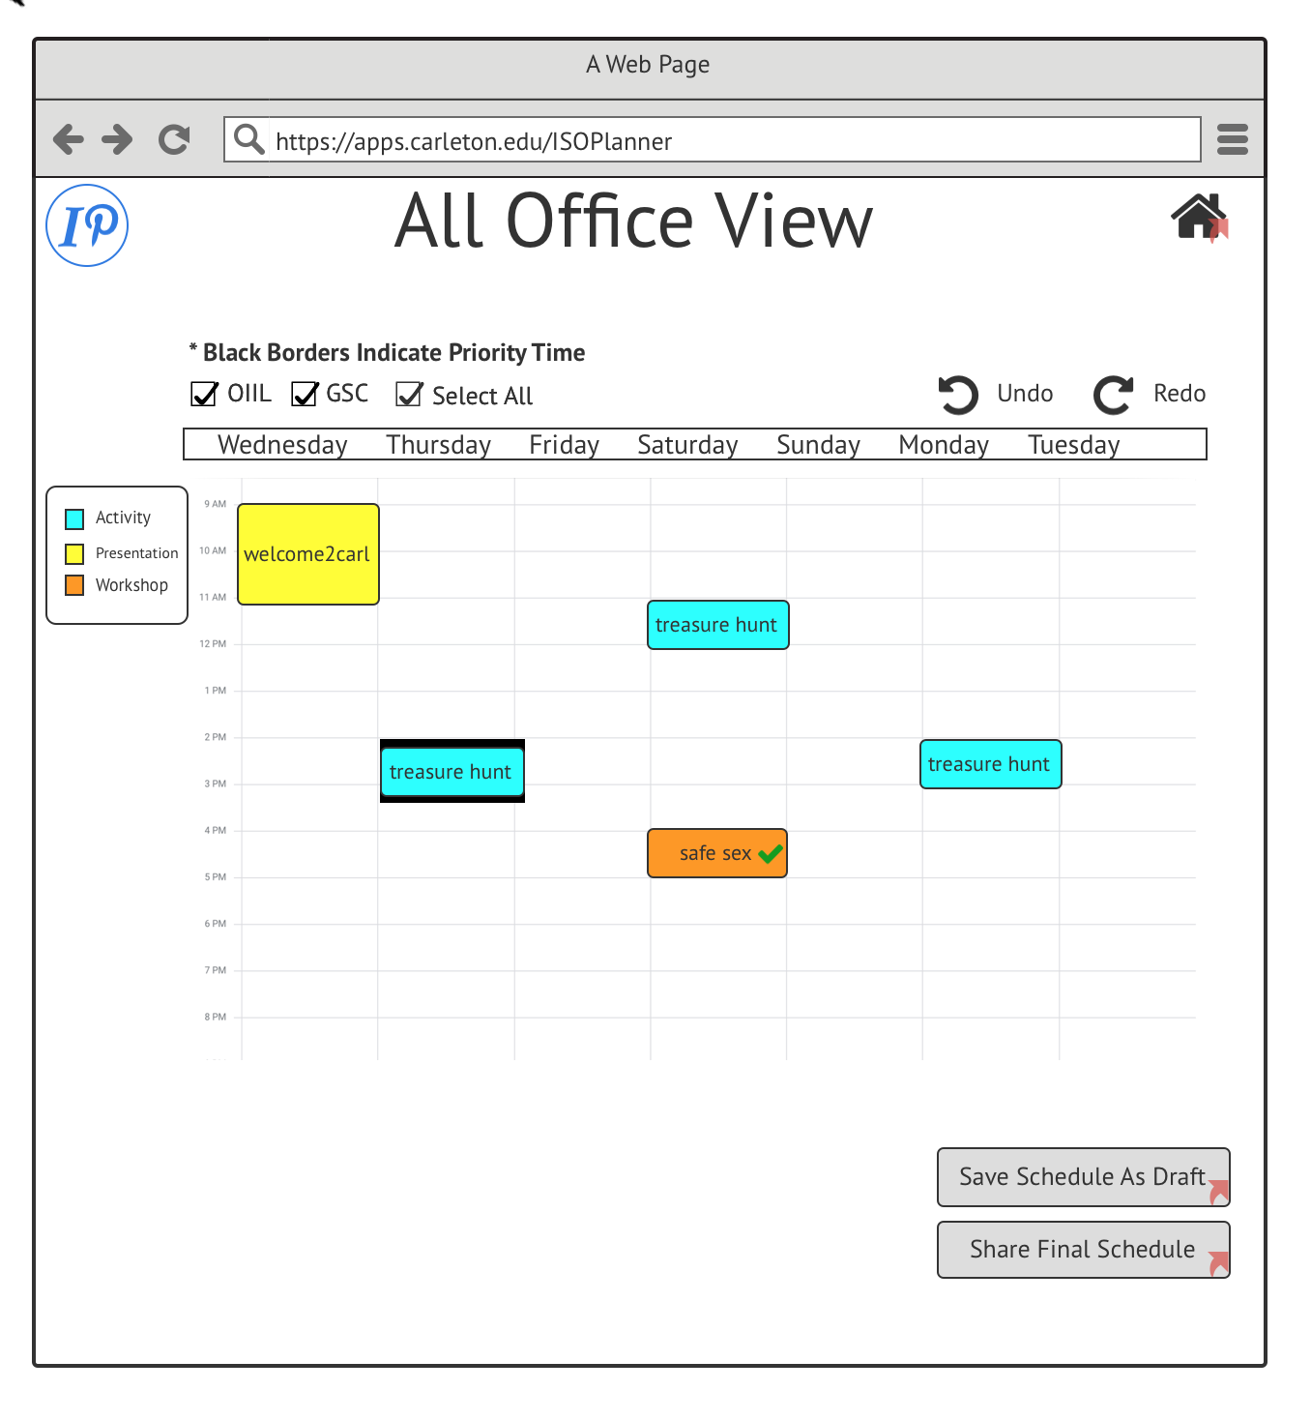

Slide 13
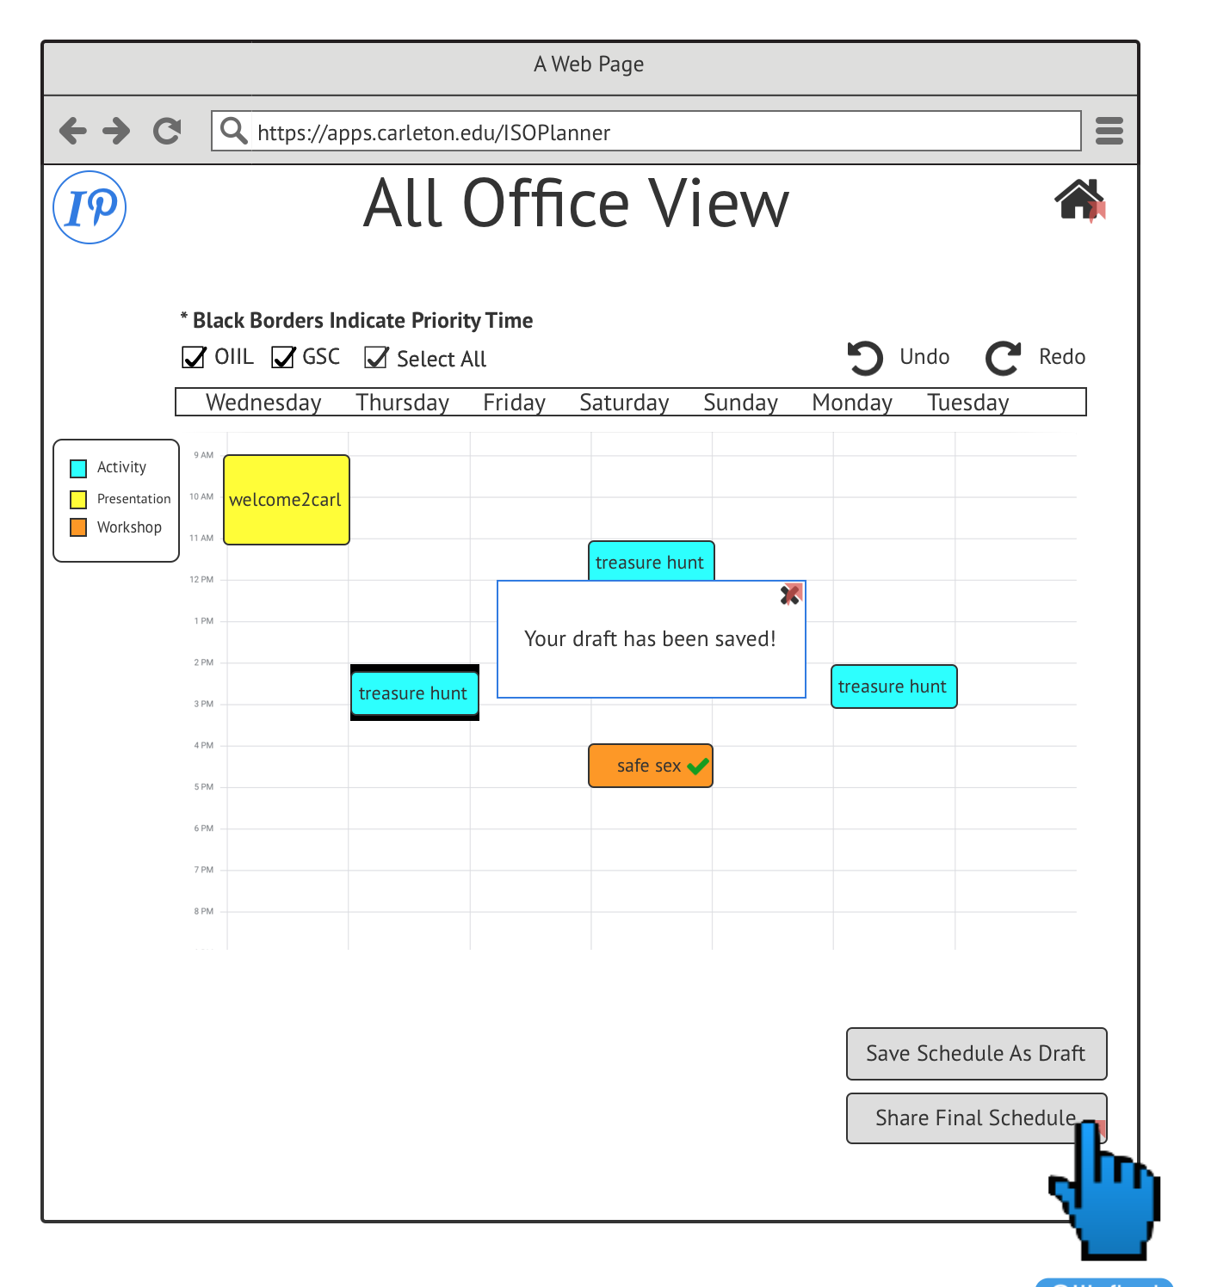

Slide 14
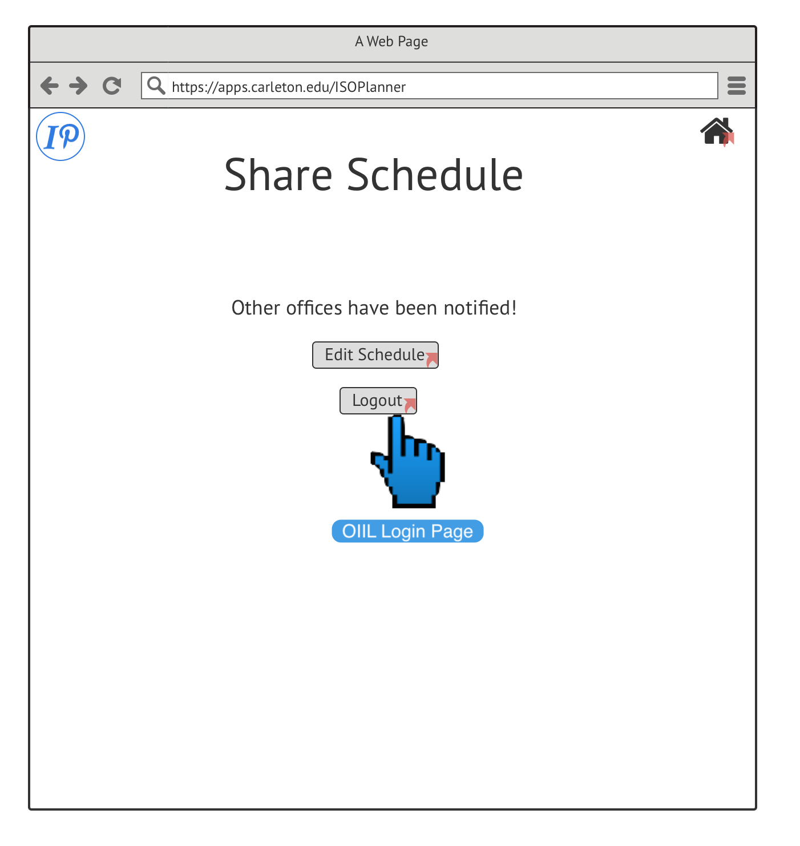

Slide 15
Wireframes: Other Office View

Slide 16
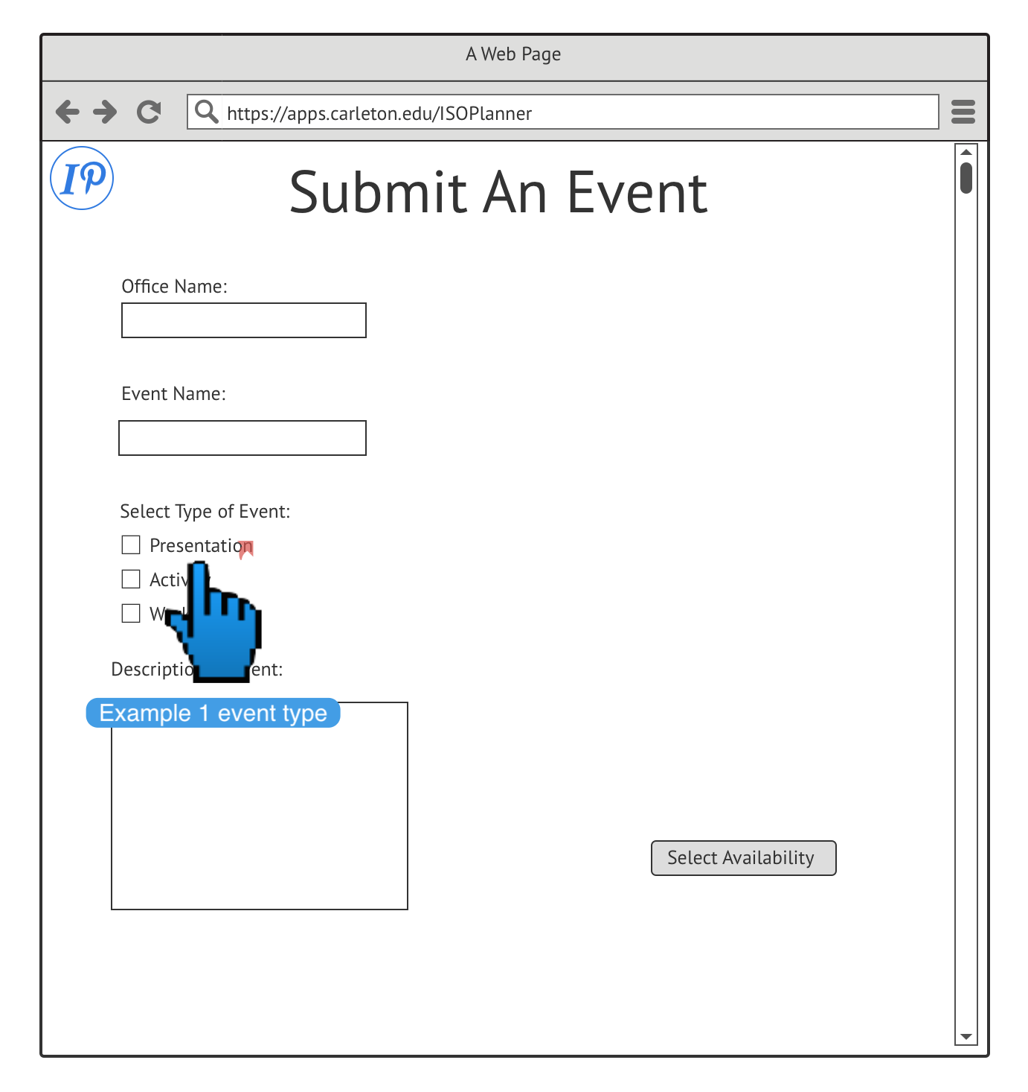

Slide 17
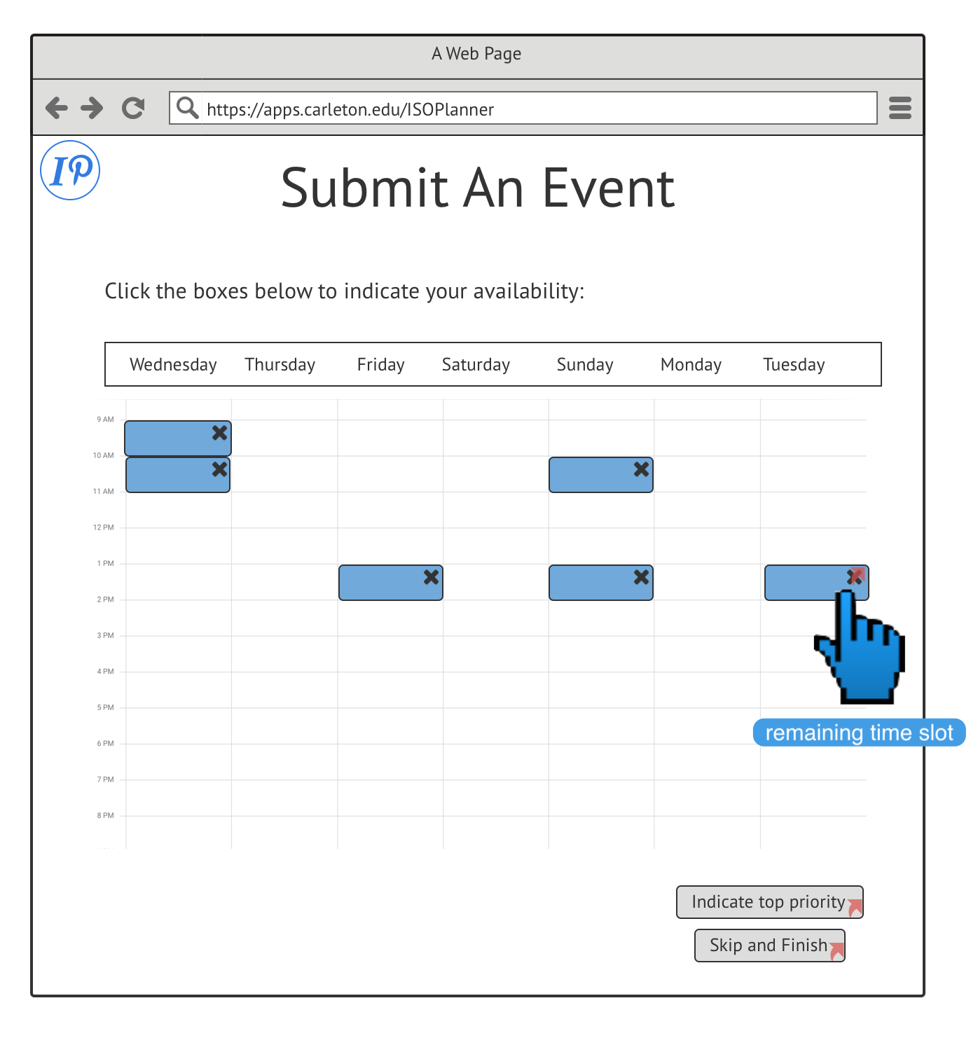

Slide 18
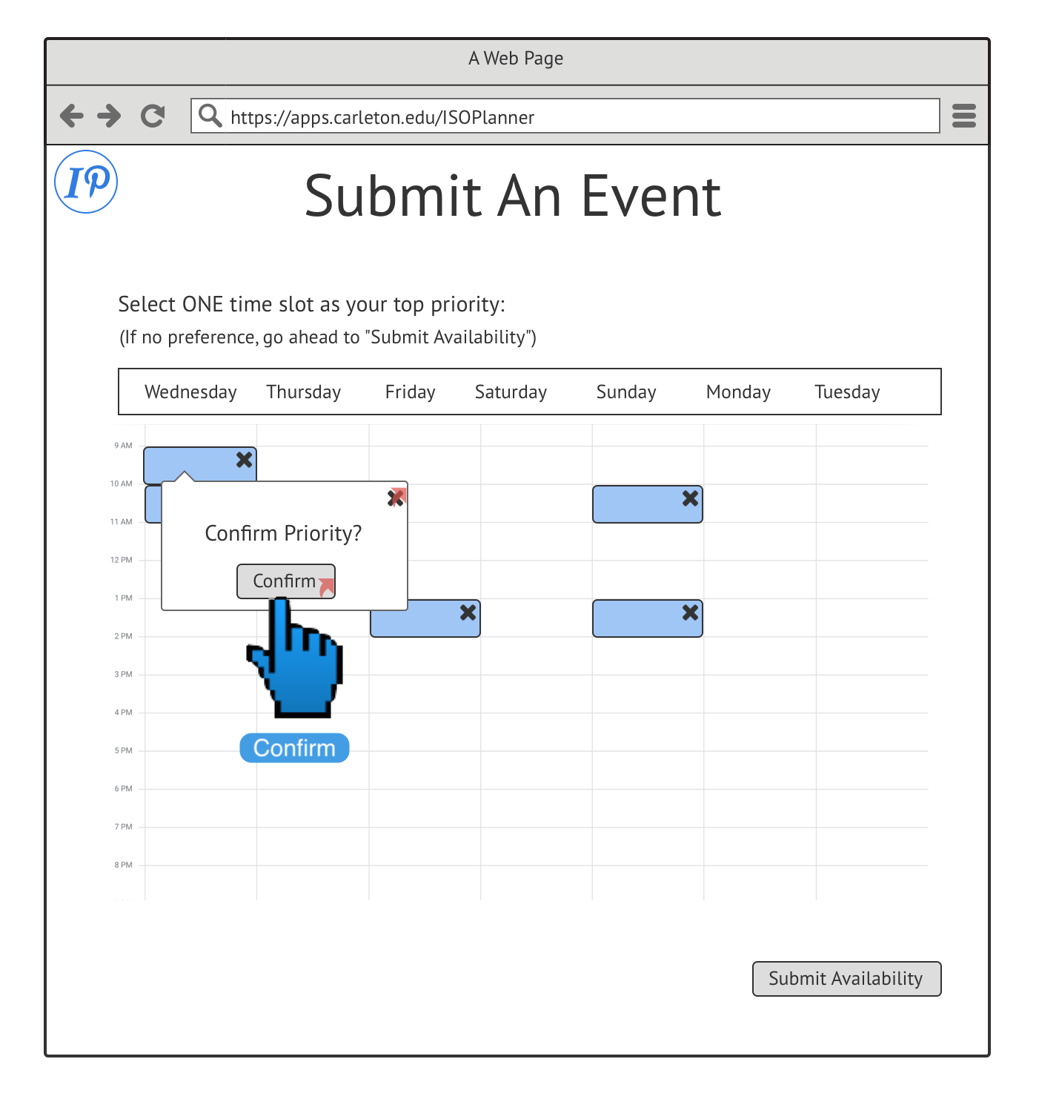

Slide 19
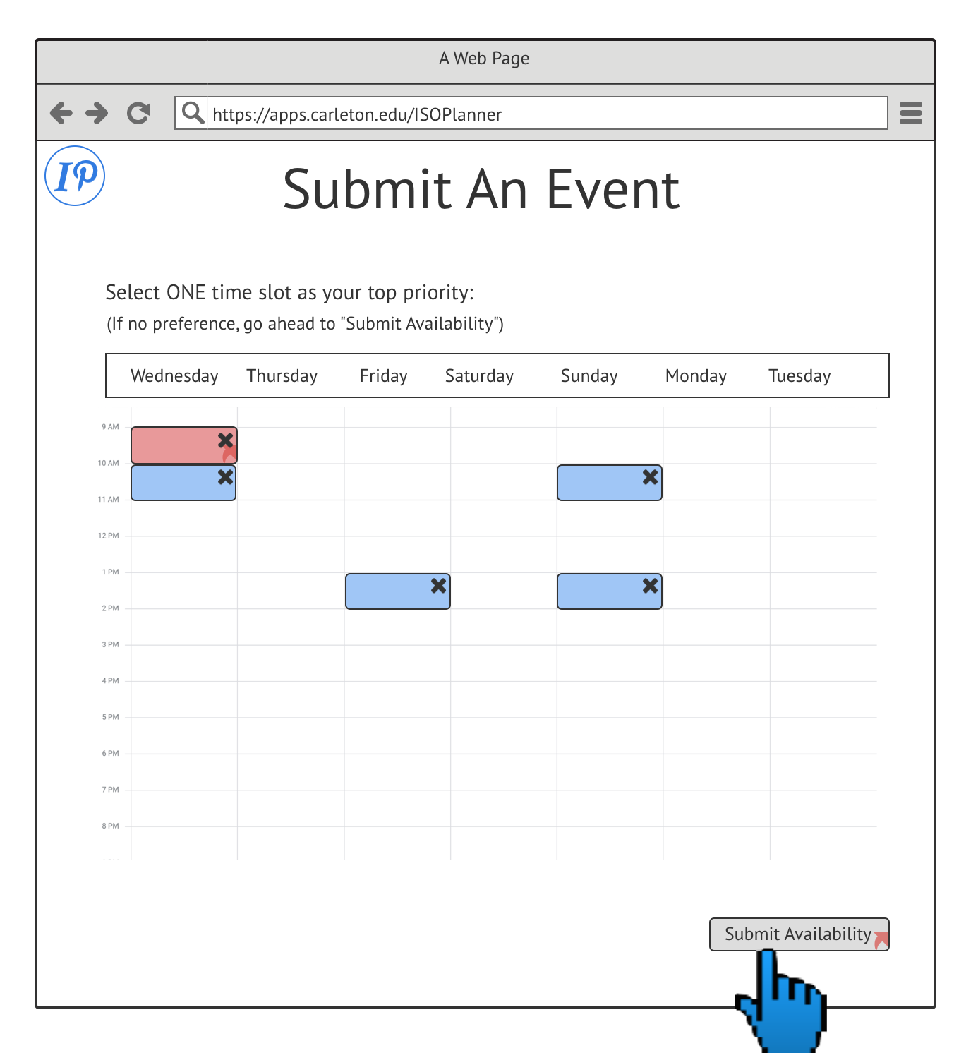

Slide 20
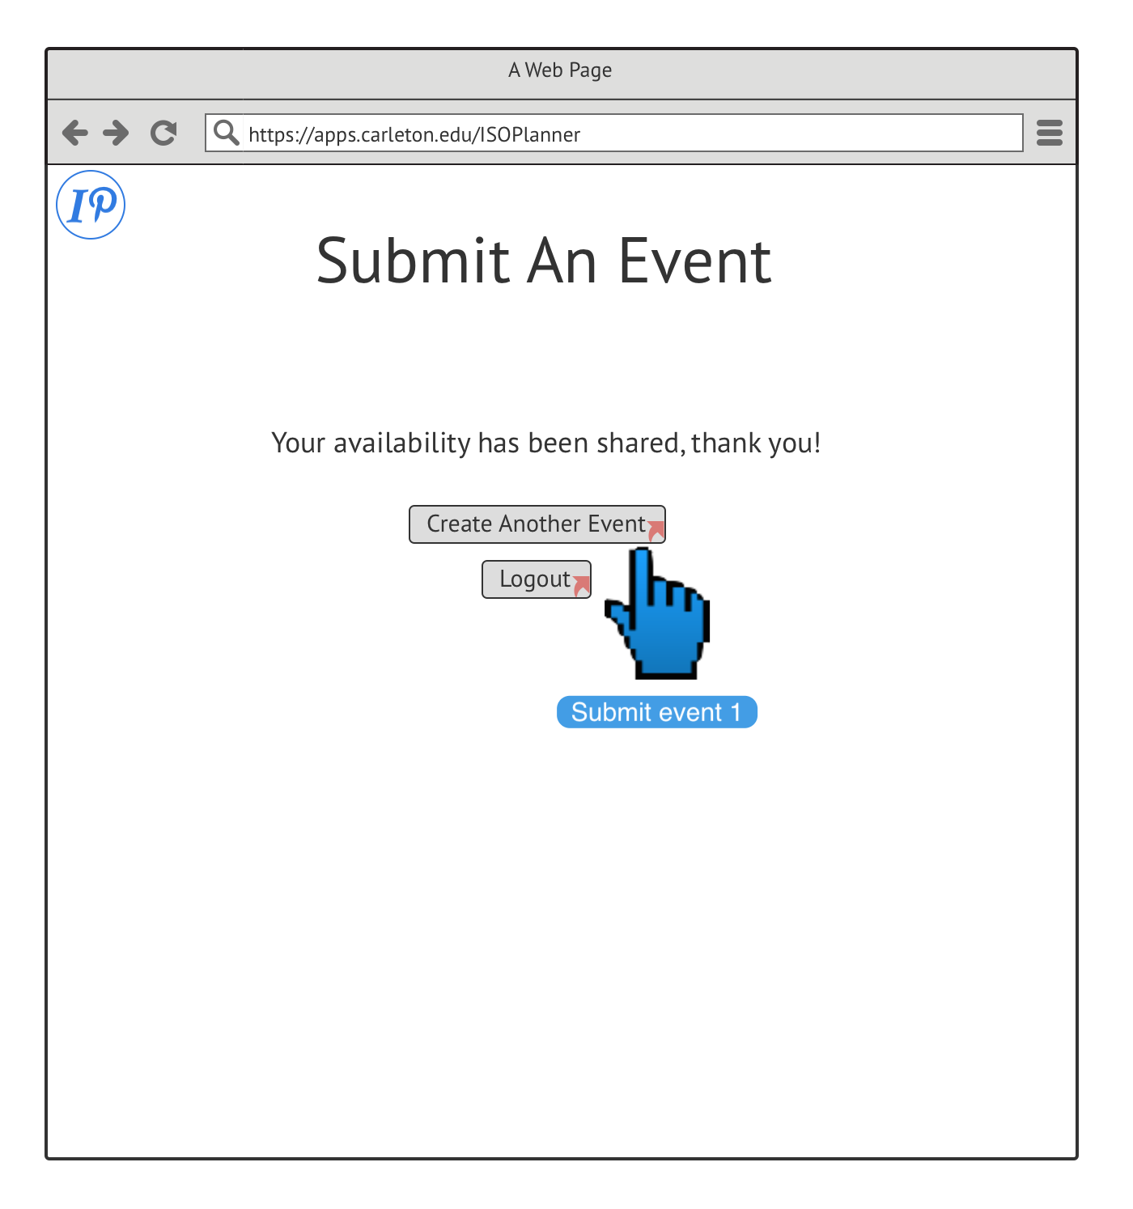

Slide 21
Usability Testing and Feedback
Original design didn’t flow well logically , had to completely redesign before usability testing
OIIL and “Other Office” users were able to complete all of their tasks in a reasonable amount of time on updated prototype
Areas of confusion included certain wireframe restrictions and some design choices
Notes:
Sneha’s feedback, then Brisa’s feedback MENTION RED BORDERS, missing home link etc

Slide 22
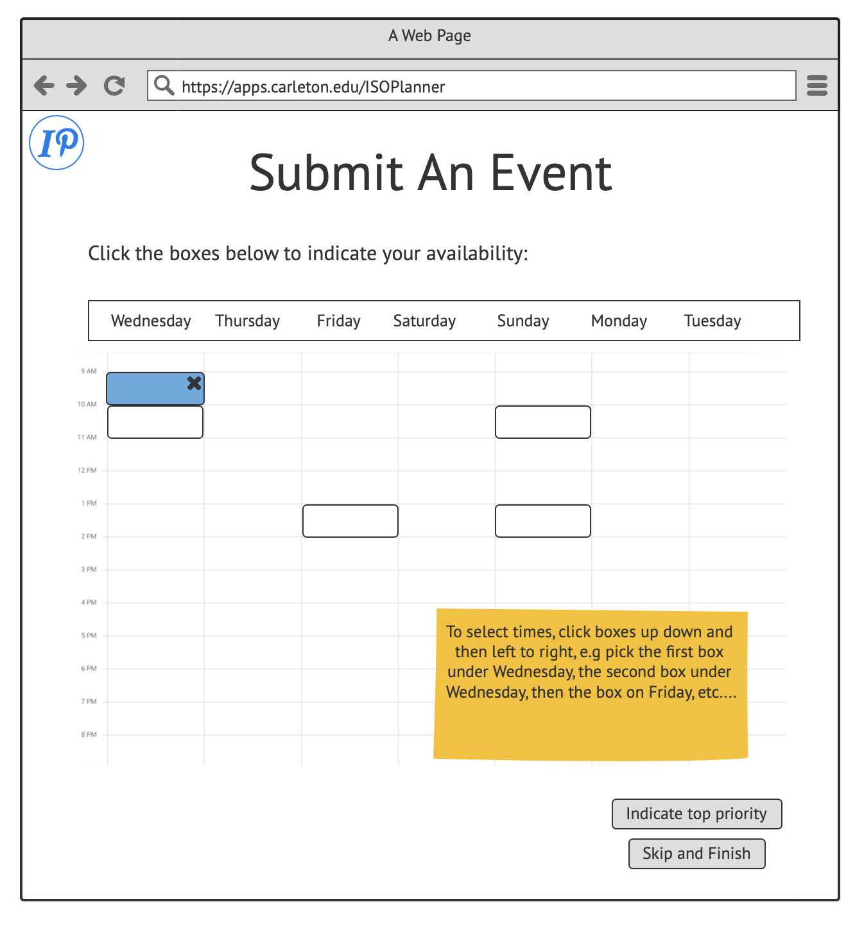

Slide 23
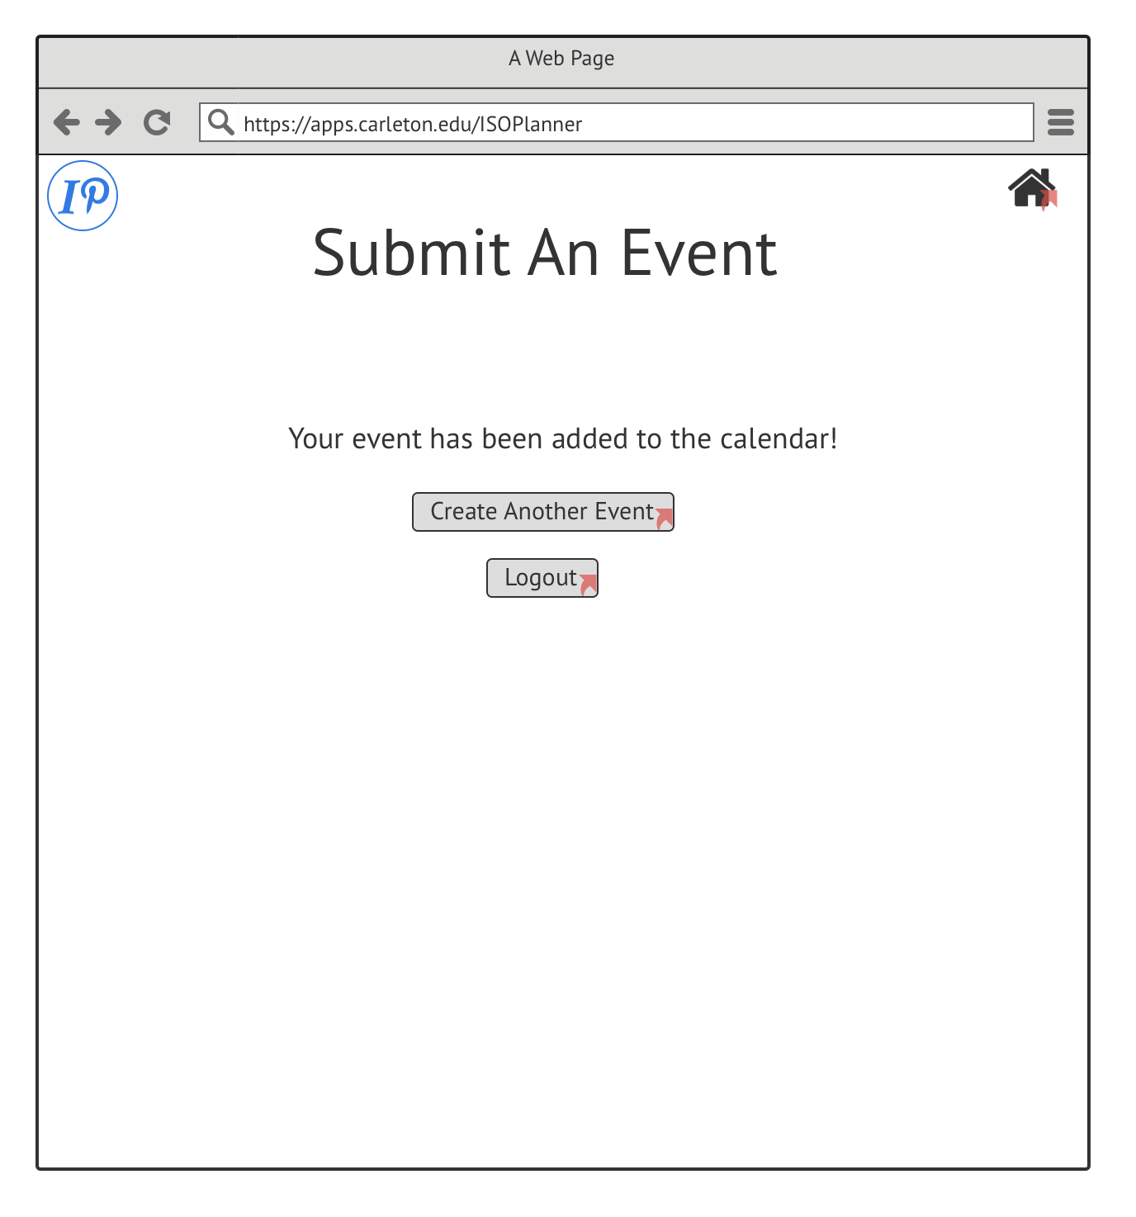

Slide 25
Next Steps
Description of events so offices can coordinate with one another
Adding missing links
Fixing elements that lacked visual indication or contrast

Slide 26
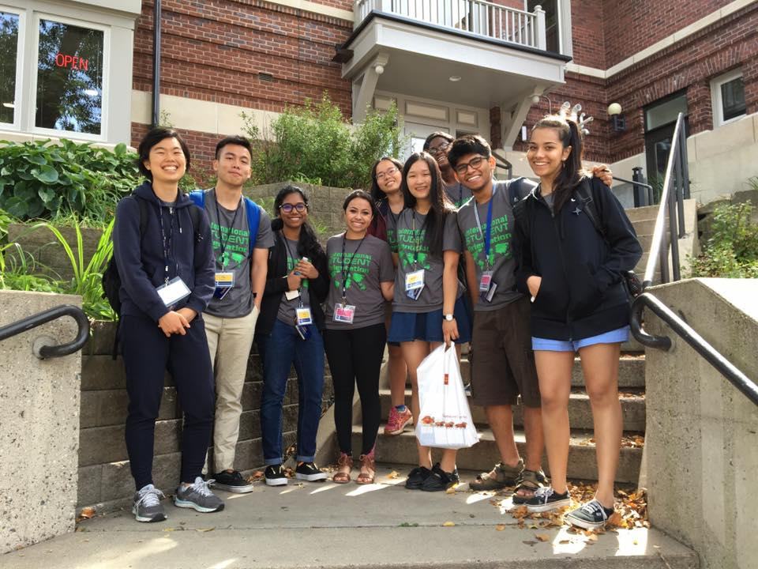
Questions?

